Slide 1
PAPER REVIEW OF NCMA – NETWORK CODED MULTIPLE ACCESS – II Lizhao You, Student Member, IEEE Soung Chang Liew, Fellow, IEEE Lu Lu, Member, IEEE
RS GIRISH
EE20RESCH14005
EE7330

Slide 2
FLOW OF PRESENTATION
INTRODUCTION
ARCHITECTURE OF NCMA
NCMA – I
PHY – LAYER DECODING AND BRIDGING
MAC – LAYER DECODING AND BRIDGING
TES
UES
NCMA – SIC
EXPERIMENTAL OUTCOMES
CONCLUSION

Slide 3
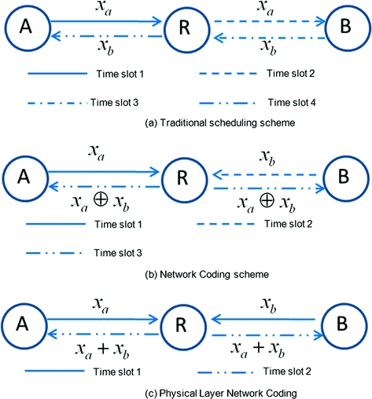


WLAN AND NC

Slide 4
ARCHITECTURE OF NCMA
NCMA MAC ERASURE CHANNEL ENCODER/ DECODER
UPPER LAYERS
NCMA PHY CHANNEL ENCODER/ DECODER
802.11 MAC FRAME FRAGMENTATION/ DEFRAGMENTATION
802.11 PHY CHANNEL ENCODER/ DECODER
JUMBOGRAM OR
OTHER LARGE MESSAGES
M
REED – SOLOMON CODE
C₁,C₂,C₃….
CONVOLUTIONAL CODE
NCMA
X₁,X₂,X₃….
PREAMBLE PROCESSING
PHY PACKETS

Slide 5
Packet transmission

Slide 6











OVERALL PHY LAYER DECODING
SINGLE USER DECODER
USER DETECTOR
SU SOFT DEMODULATOR
RMUD DEMODULATOR
PNC SOFT DEMODULATOR
BINARY VITERBI DECODER
SIC DECODER
BINARY VITERBI DECODER
BINARY VITERBI DECODER
BINARY VITERBI DECODER
$$\left\{{\tilde{x}}_{A}\left[k\right]\right\}$$
$$C_{i}^{A}$$
SINGLE USER
or $\left\{{\tilde{x}}_{B}\left[k\right]\right\}$
$${or C}_{i}^{B}$$
MUD DECODER
$$C_{i}^{A}$$
$$\left\{{\tilde{x}}_{A}\left[k\right]\right\}$$
OPTION 1
$$\left\{y\left[k\right]\right\}$$
$$\left\{{\tilde{x}}_{B}\left[k\right]\right\}$$
OPTION 2
$$C_{i}^{B}$$
TWO USERS
PNC DECODER
$$\left\{{\tilde{x}}_{A⊕B}\left[k\right]\right\}$$
$$C_{i}^{A}⊕C_{i}^{B}$$

Slide 7


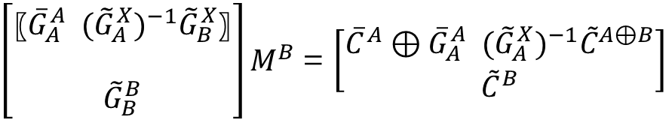


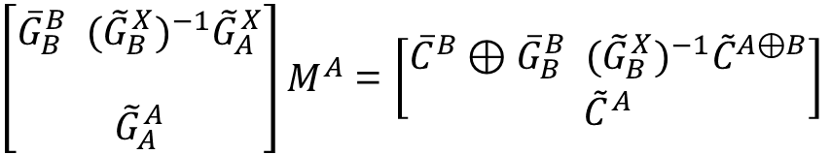
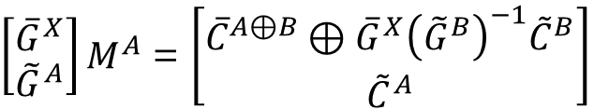
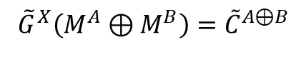
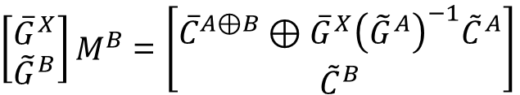

MAC LAYER DECODING AND BRIDGING - THREE EQUATION SYSTEM
$\left[\begin{matrix}{\overline{G}}^{X} \\ {\tilde{G}}^{B}\end{matrix}\right]M^{B}$ = $\left[\begin{matrix}{\overline{C}}^{A⊕B}⊕{\overline{G}}^{X}{\left({\tilde{G}}^{A}\right)}^{−1}{\tilde{C}}^{A} \\ {\tilde{C}}^{B}\end{matrix}\right]$
$${\tilde{G}}^{A}M^{A}={\tilde{C}}^{A}$$
$${\tilde{G}}^{B}M^{B}={\tilde{C}}^{B}$$
$\left[\begin{matrix}{\overline{G}}^{X} \\ {\tilde{G}}^{A}\end{matrix}\right]M^{A}$ = $\left[\begin{matrix}{\overline{C}}^{A⊕B}⊕{\overline{G}}^{X}{\left({\tilde{G}}^{B}\right)}^{−1}{\tilde{C}}^{B} \\ {\tilde{C}}^{A}\end{matrix}\right]$
$$C_{i}^{A}=G_{i}M^{A}$$
$$C_{i}^{B}=G_{i}M^{B}$$
$${\tilde{G}}^{X}\left(M^{A}⊕M^{B}\right)={\tilde{C}}^{A⊕B}$$
$\left[\begin{aligned}\begin{matrix}{\overline{G}}_{B}^{B} ({{\tilde{G}}_{B}^{X})}^{−1}{\tilde{G}}_{A}^{X} \\ \end{matrix} \\ {\tilde{G}}_{A}^{A}\end{aligned}\right]M^{A}$ = $\left[\begin{matrix}{\overline{C}}^{B}⊕{\overline{G}}_{B}^{B} ({{\tilde{G}}_{B}^{X})}^{−1}{\tilde{C}}^{A⊕B} \\ {\tilde{C}}^{A}\end{matrix}\right]$
$\left[\begin{aligned}\begin{matrix}〖{\overline{G}}_{A}^{A} ({{\tilde{G}}_{A}^{X})}^{−1}{\tilde{G}}_{B}^{X}〗 \\ \end{matrix} \\ {\tilde{G}}_{B}^{B}\end{aligned}\right]M^{B}$ = $\left[\begin{matrix}{\overline{C}}^{A}⊕{\overline{G}}_{A}^{A} ({{\tilde{G}}_{A}^{X})}^{−1}{\tilde{C}}^{A⊕B} \\ {\tilde{C}}^{B}\end{matrix}\right]$

Slide 8
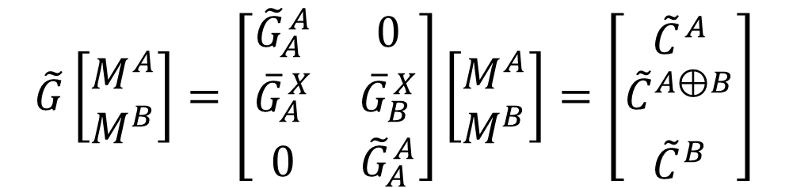
MAC LAYER DECODING AND BRIDGING - UNIFIED EQUATION SYSTEM
$$\tilde{G}\left[\begin{matrix}M^{A} \\ M^{B}\end{matrix}\right]=\left[\begin{matrix}{\tilde{G}}_{A}^{A} & 0 \\ {\overline{G}}_{A}^{X} & {\overline{G}}_{B}^{X} \\ 0 & {\tilde{G}}_{A}^{A}\end{matrix}\right]\left[\begin{matrix}M^{A} \\ M^{B}\end{matrix}\right]=\left[\begin{aligned}{\tilde{C}}^{A} \\ {\tilde{C}}^{A⊕B} \\ \begin{matrix} \\ {\tilde{C}}^{B}\end{matrix}\end{aligned}\right]$$

Slide 9
DECODED INFORMATION

Slide 10
EXPERIMENTAL SETUP
SDR – USRP N210
HIGH CONFIGURATION PC WITH GIGABIT ETHERNET
HIGH RESOLUTION GPS CLOCKS
OFDM – SIMILAR TO 802.11
DATA – BPSK MODULATED
PHY LAYER – ½ CONVOLUTIONAL CODE AND SOFT VITERBI DECODER
REDUCED CONSTELLATION SCHEME
MAC LAYER – RS ERASURE CODE
BEACON LEAD TRIGGERS FOR SYNCHRONIZATION TRANSMISSION OF PACKETS

Slide 11
EXPERIMENTAL EVALUATION PARAMETERS
MESSAGE PROCESSING TIME
NORMALIZED THROUGHPUT

Slide 12

EXPERIMENTAL OUTCOMES
THROUGHPUT VS RANGED SNR

Slide 13
EXPERIMENTAL OUTCOMES (CONTD.)
NORMALIZED THROUGHPUT VS SNR

Slide 14




NCMA II WITH NC – SIC
$$C_{i}^{A}, C_{i}^{B} or C_{i}^{A}⊕C_{i}^{B}$$
MUD, PNC DECODERS
ONLY ONE PACKET DECODED?
PHY – LAYER BRIDGING
MAC – LAYER BRIDGING
$$M_{}^{A}{,M}_{}^{B}$$
NO
YES
TWO USER
OVERLAPPED SIGNALS
i)
ii)
SIC
$$\left\{\tilde{y}\left[k\right]\right\}$$
SU DECODER
$$\left\{y\left[k\right]\right\}$$

Slide 15
EXPERIMENTAL OUTCOMES (CONTD.)
NORMALIZED THROUGHPUT VS RANGED SNR

Slide 16
CONCLUSION

